Slide 1
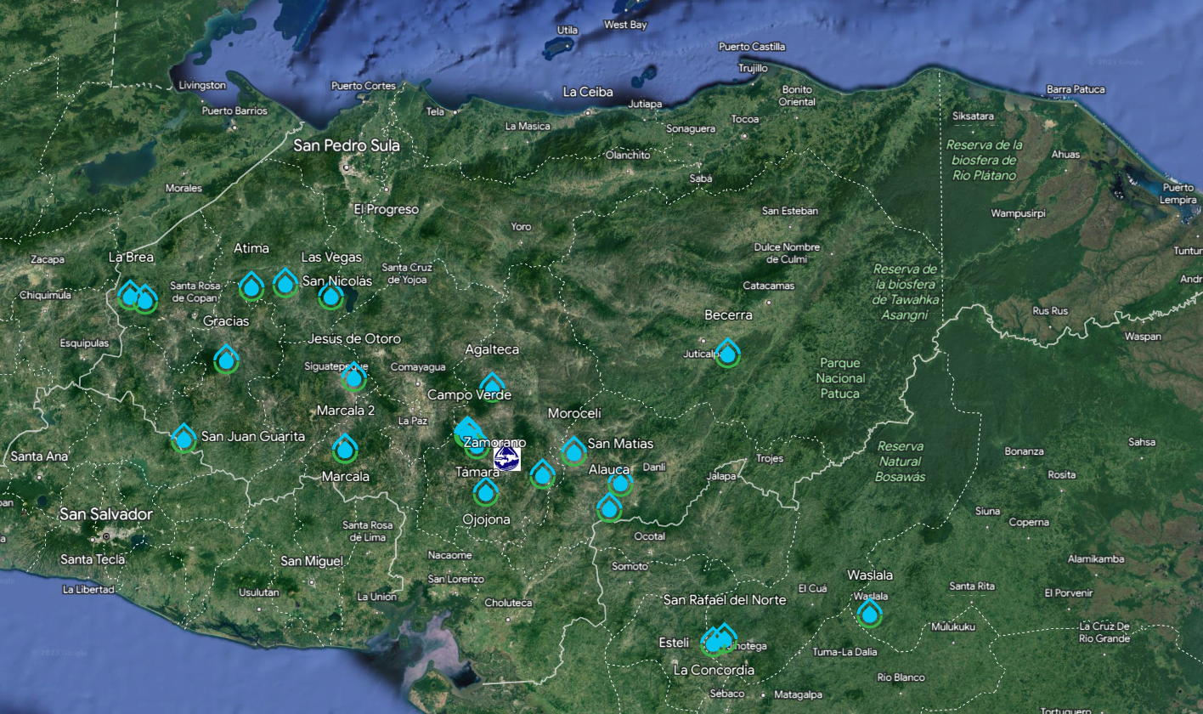

Slide 2
San Francisco de Becerra, Olancho, Honduras
6000 people
36 L/s (should have reserve capacity – this is 6 mL/s per person)
Construction currently underway
Will be a blend of our 2017 designs with a few new features
25th AguaClara plant in Central America
There will be over 100,000 people receiving water from AguaClara plants when Becerra is completed!

Slide 3
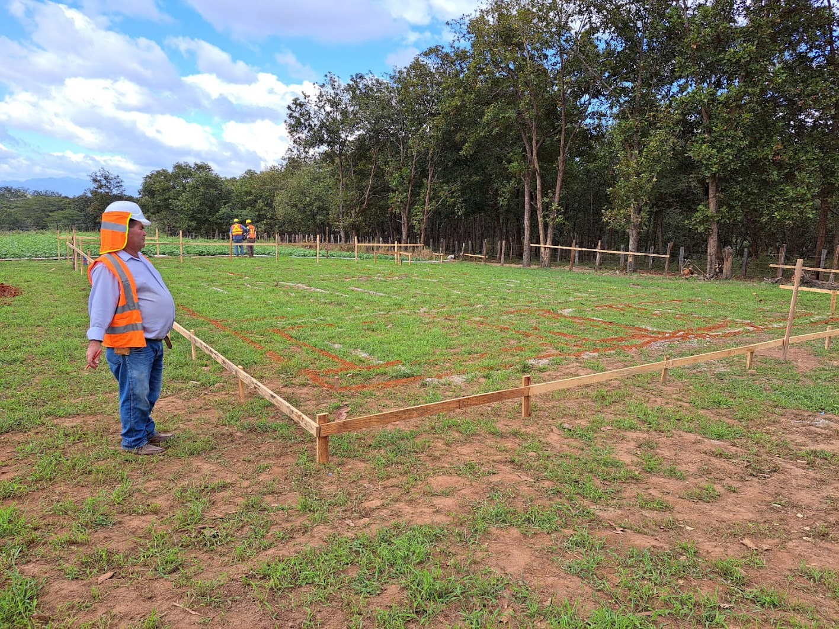
This isn’t an empty field anymore!
Lines are drawn to define where to start digging
German has supervised the construction of more AguaClara Plants than anyone else!
Notes:
See the

Slide 4
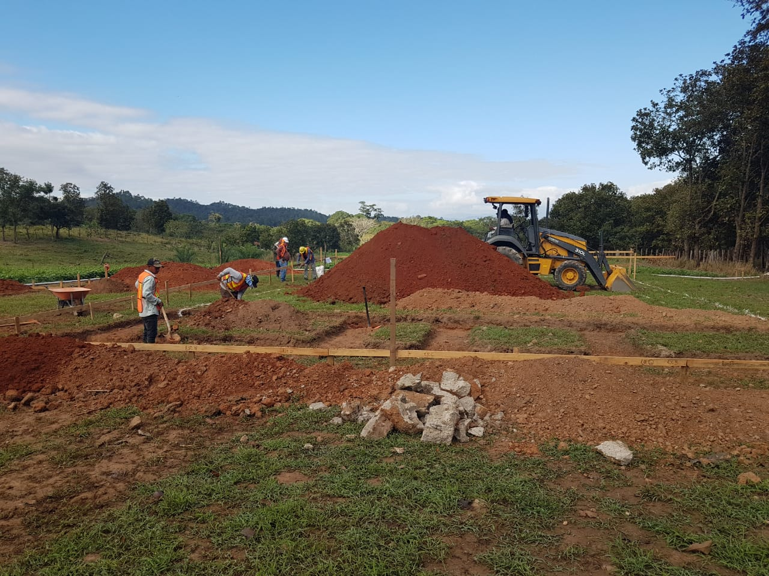

Slide 5
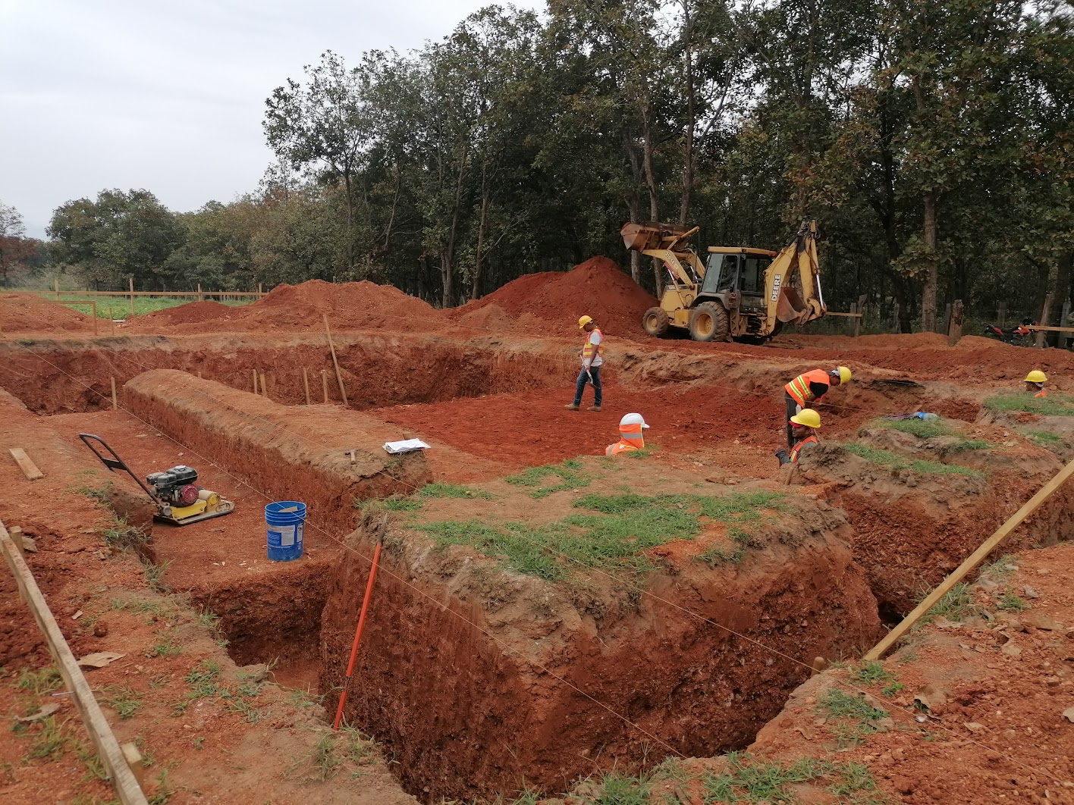
Filters
Clarifier
Floc
Entrance Tank

Slide 6
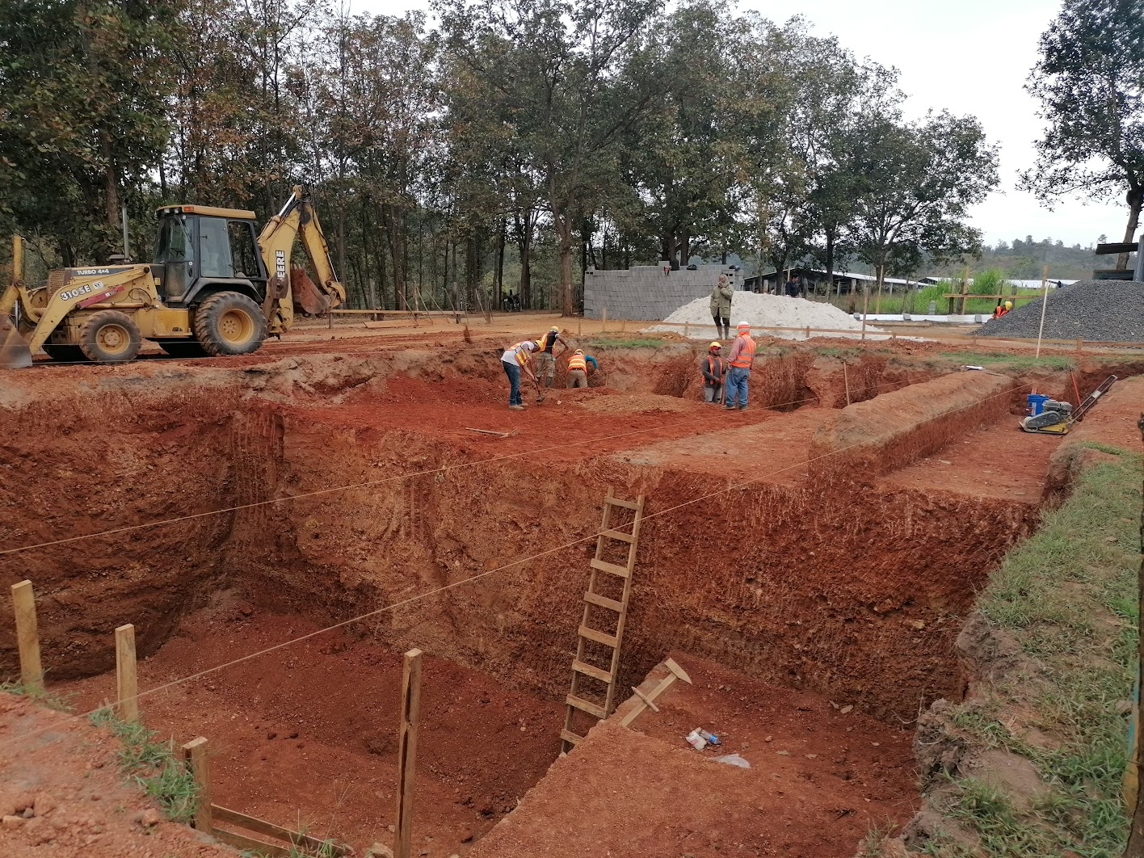

Slide 7
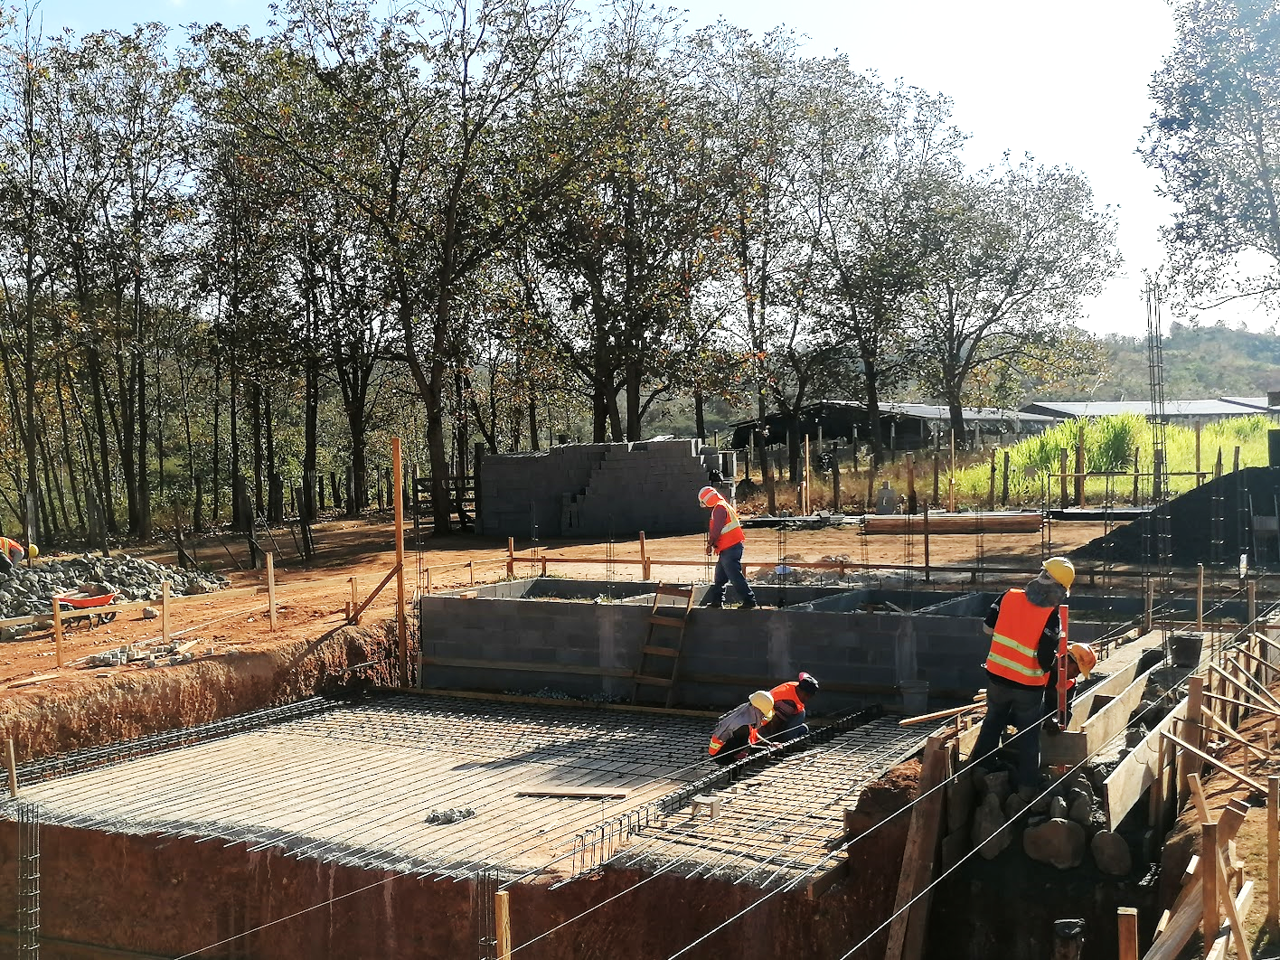
Laboratory
Sleeping room
Bathroom
?
Entrance Tank
Clarifier
Floc

Slide 8
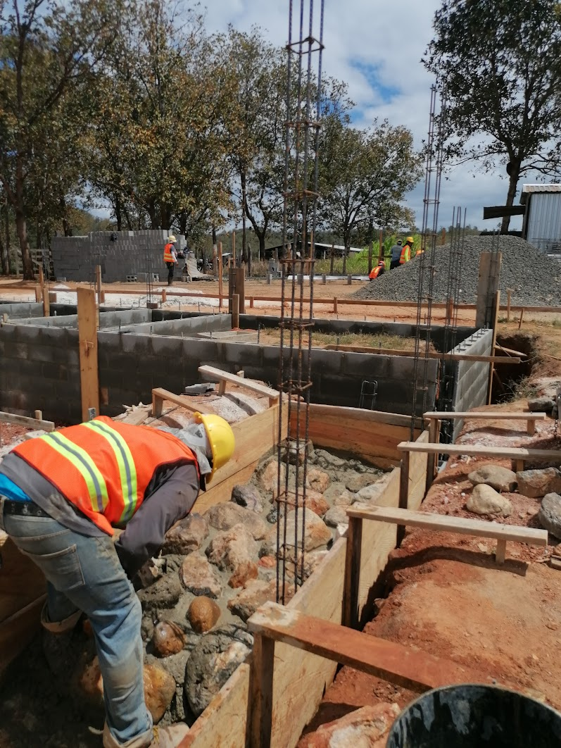
Entrance Tank Foundation

Slide 9
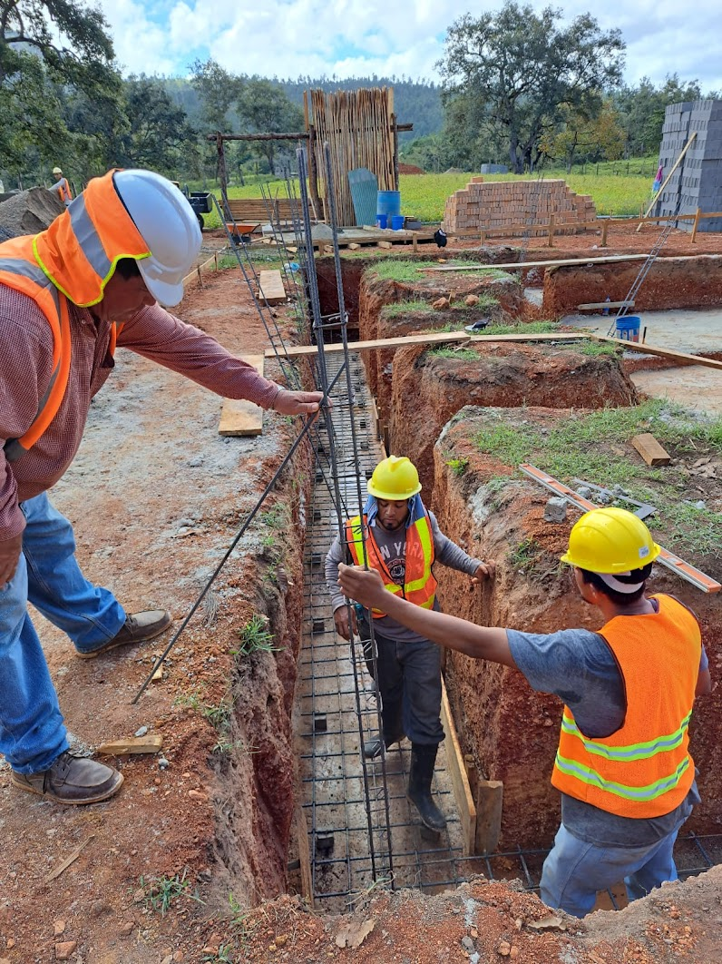
Building exterior wall foundation

Slide 10
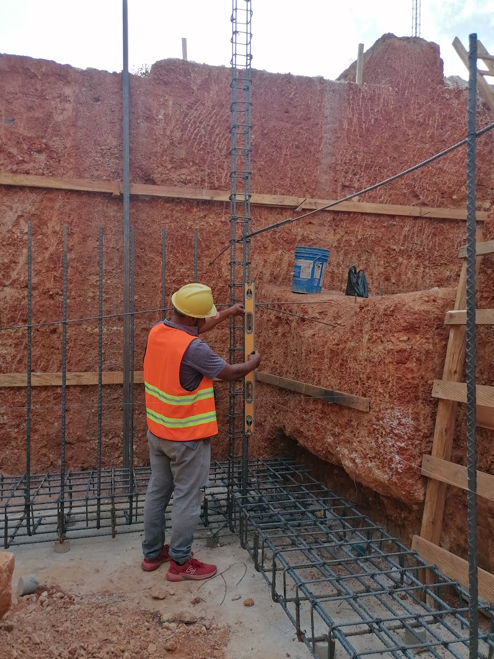
Filter foundation

Slide 11
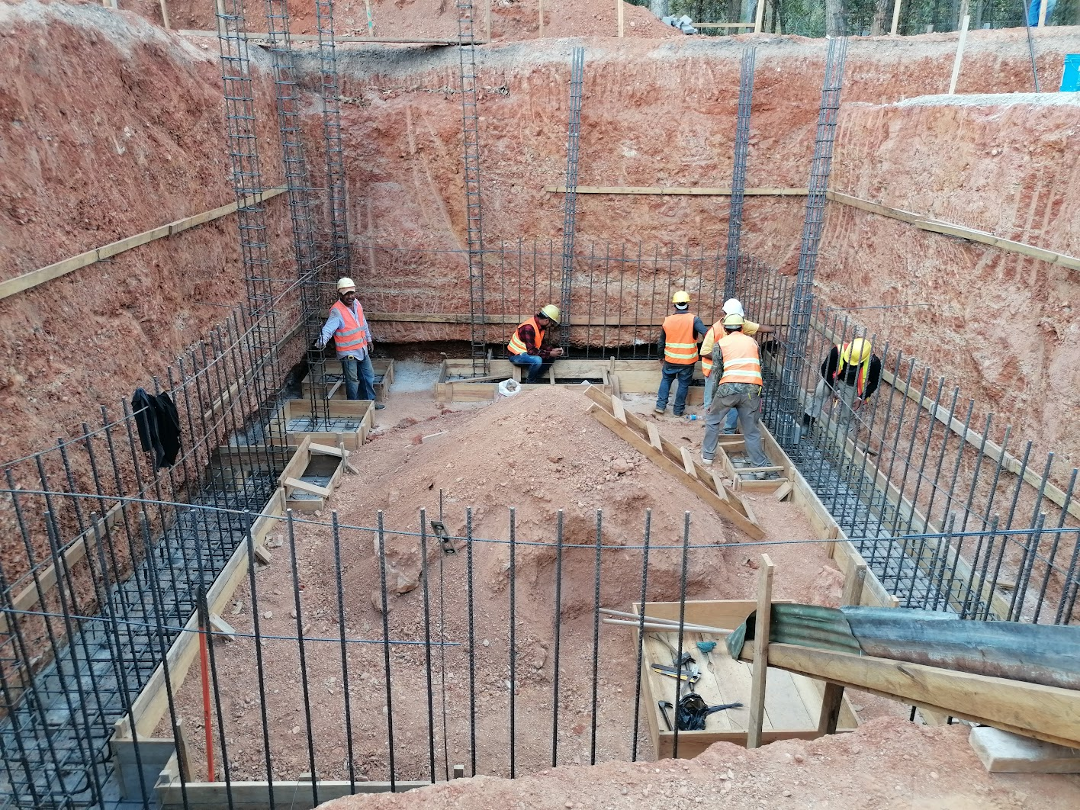
Filter and Pipe Gallery

Slide 12
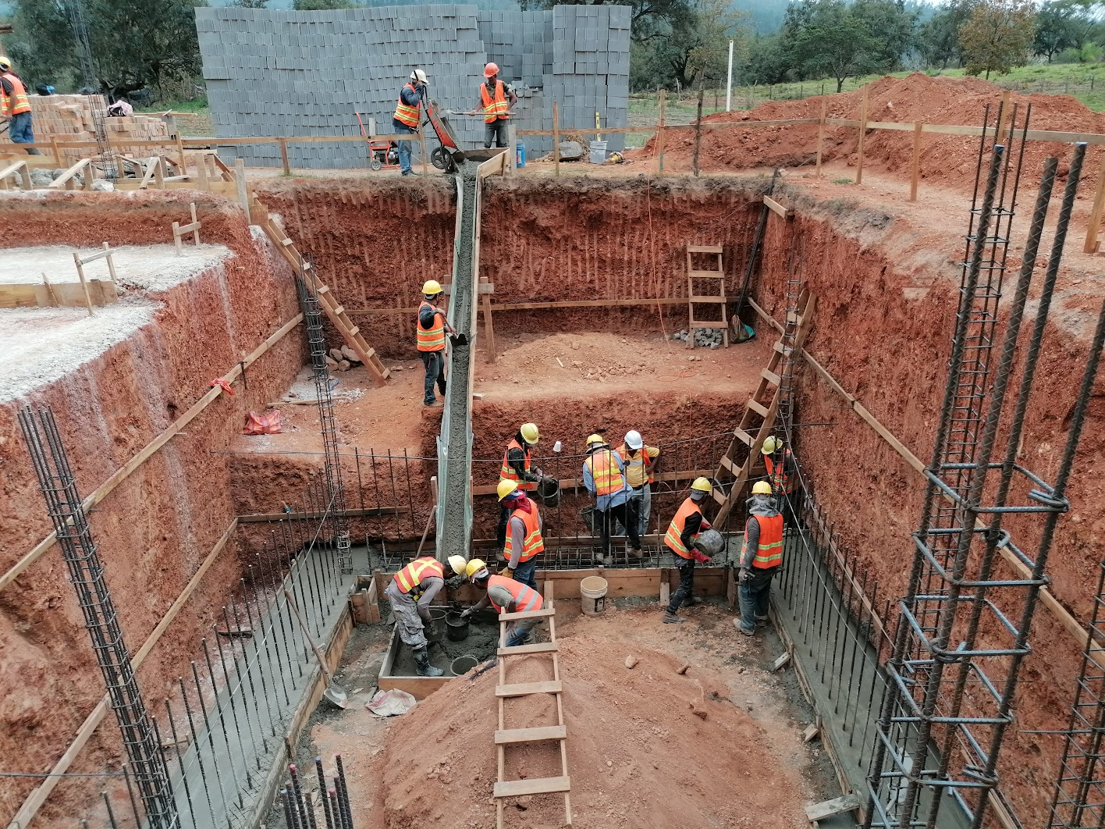

Slide 13
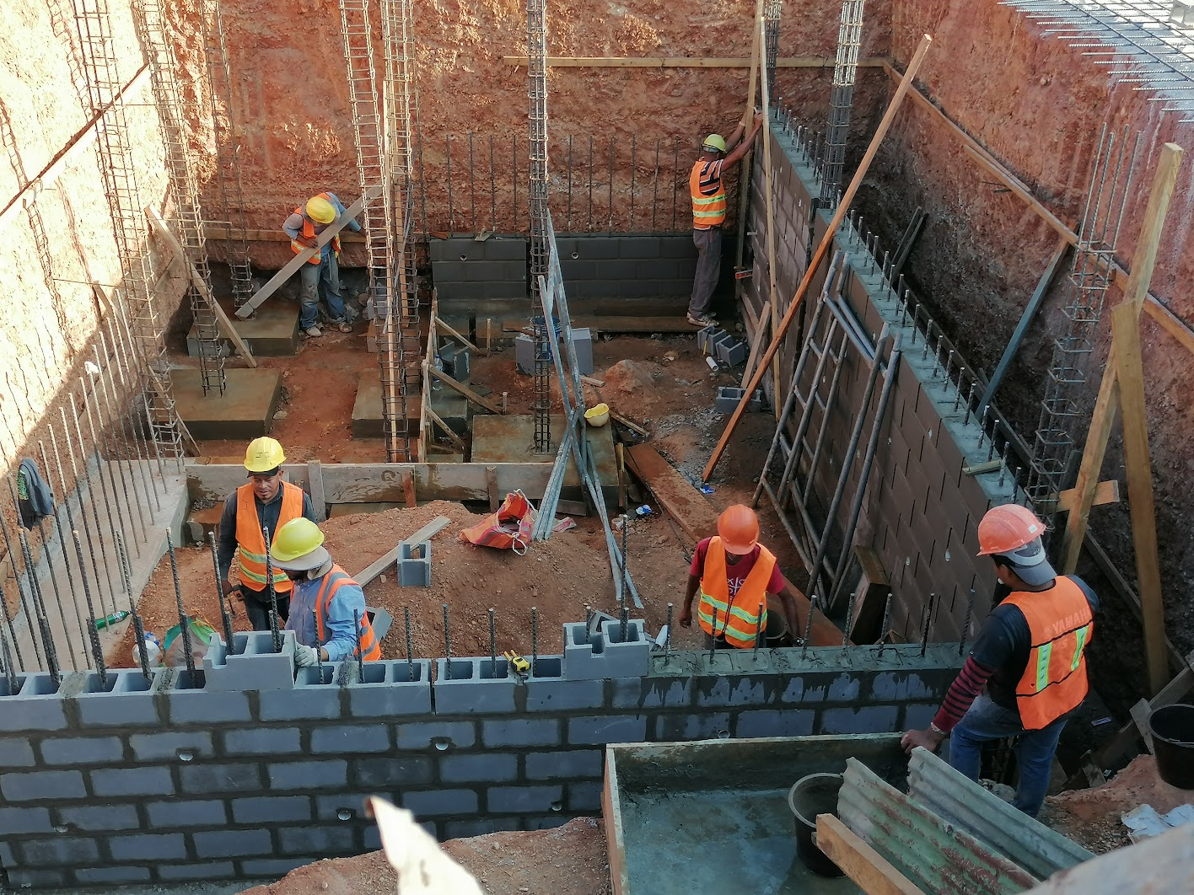
6 corners for two filters
Drain Channel

Slide 14
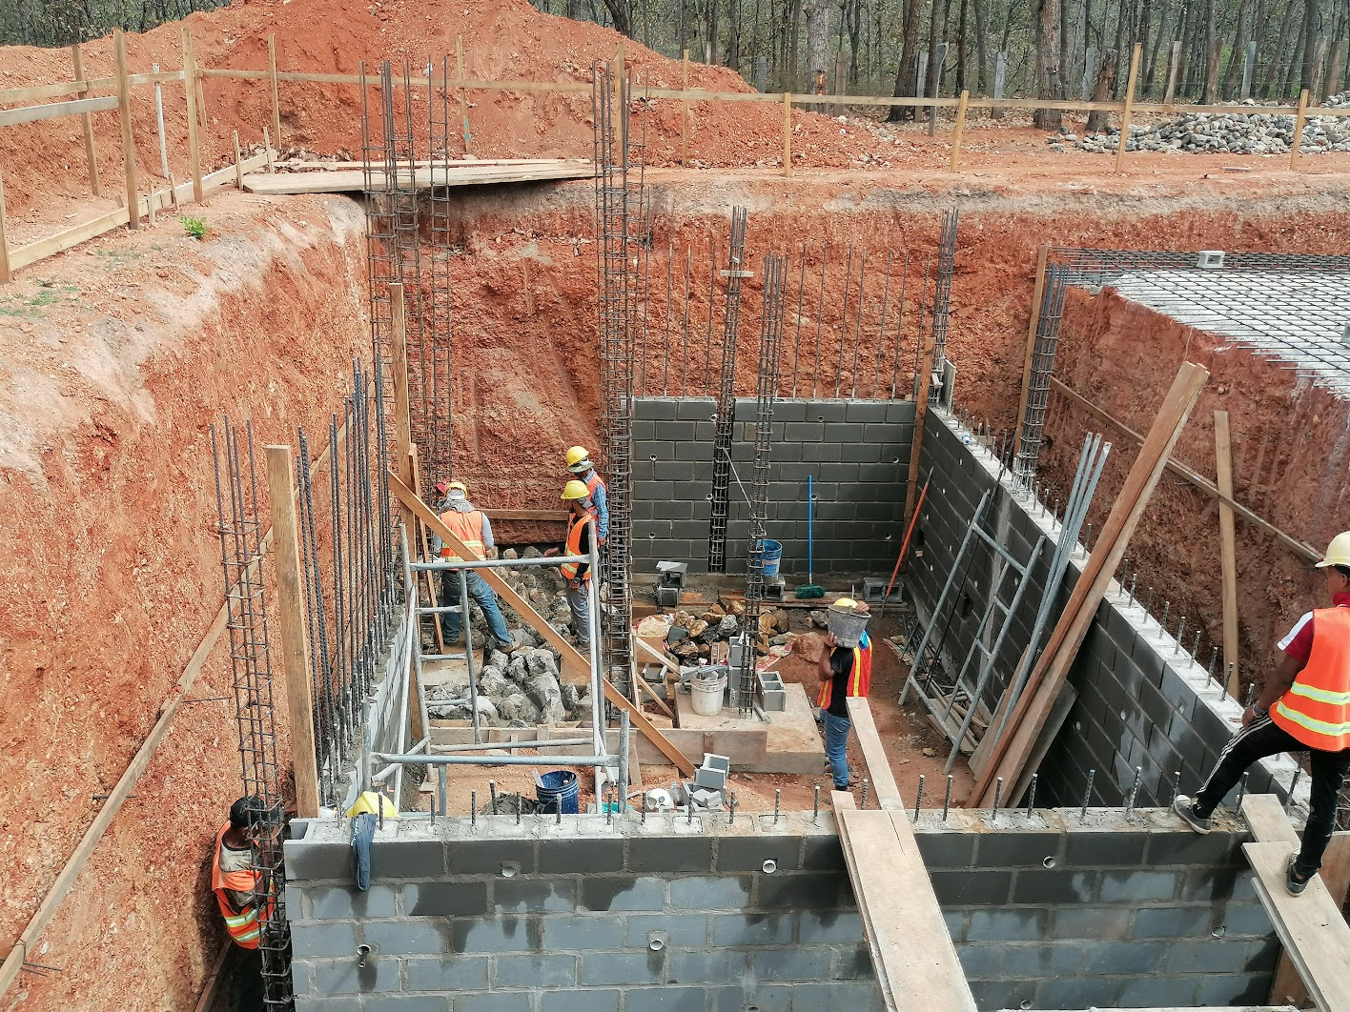
Filter Foundations

Slide 15
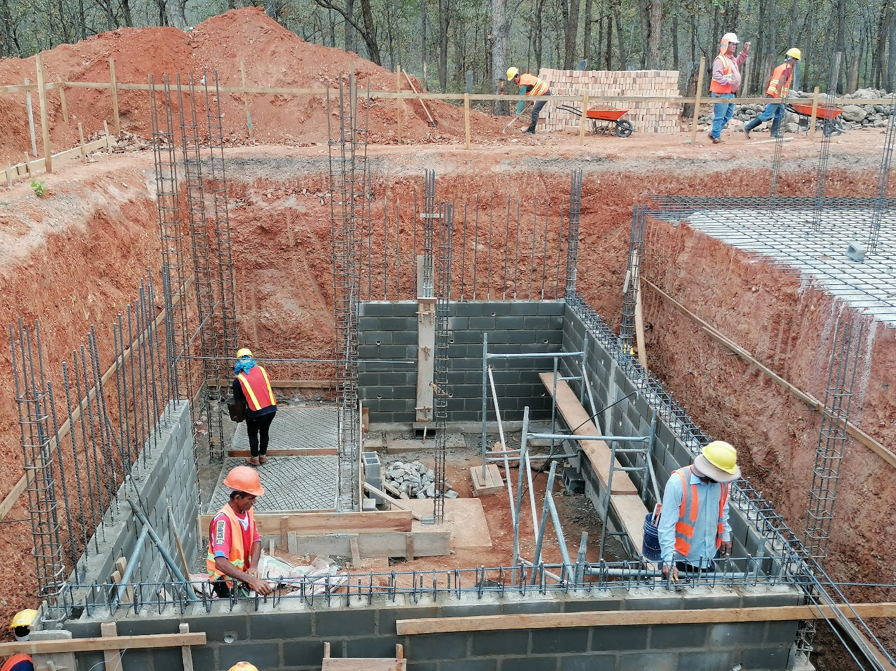
Filter Foundations

Slide 16
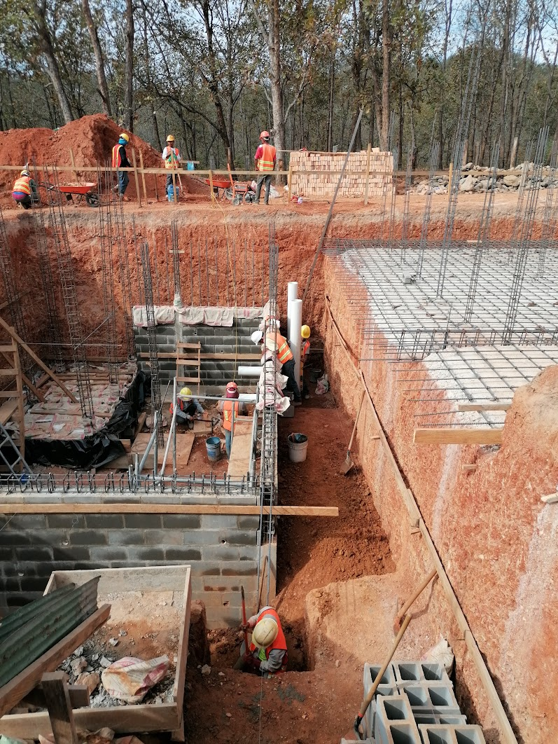
Respect! Planning!
Filter backwash drain pipes

Slide 17
Materials you can purchase from local suppliers
Bricks
Concrete blocks
Gravel
Rebar

Slide 18
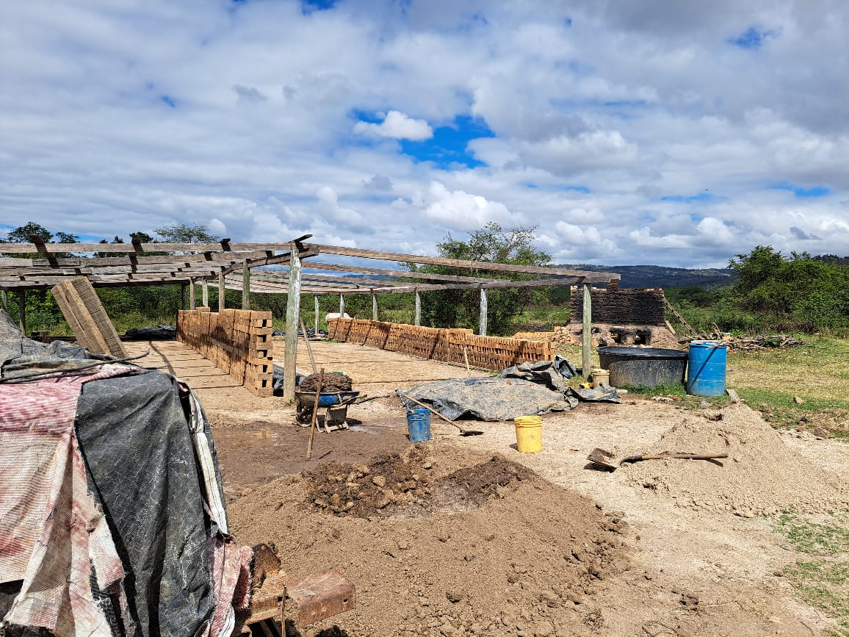
Bricks

Slide 19
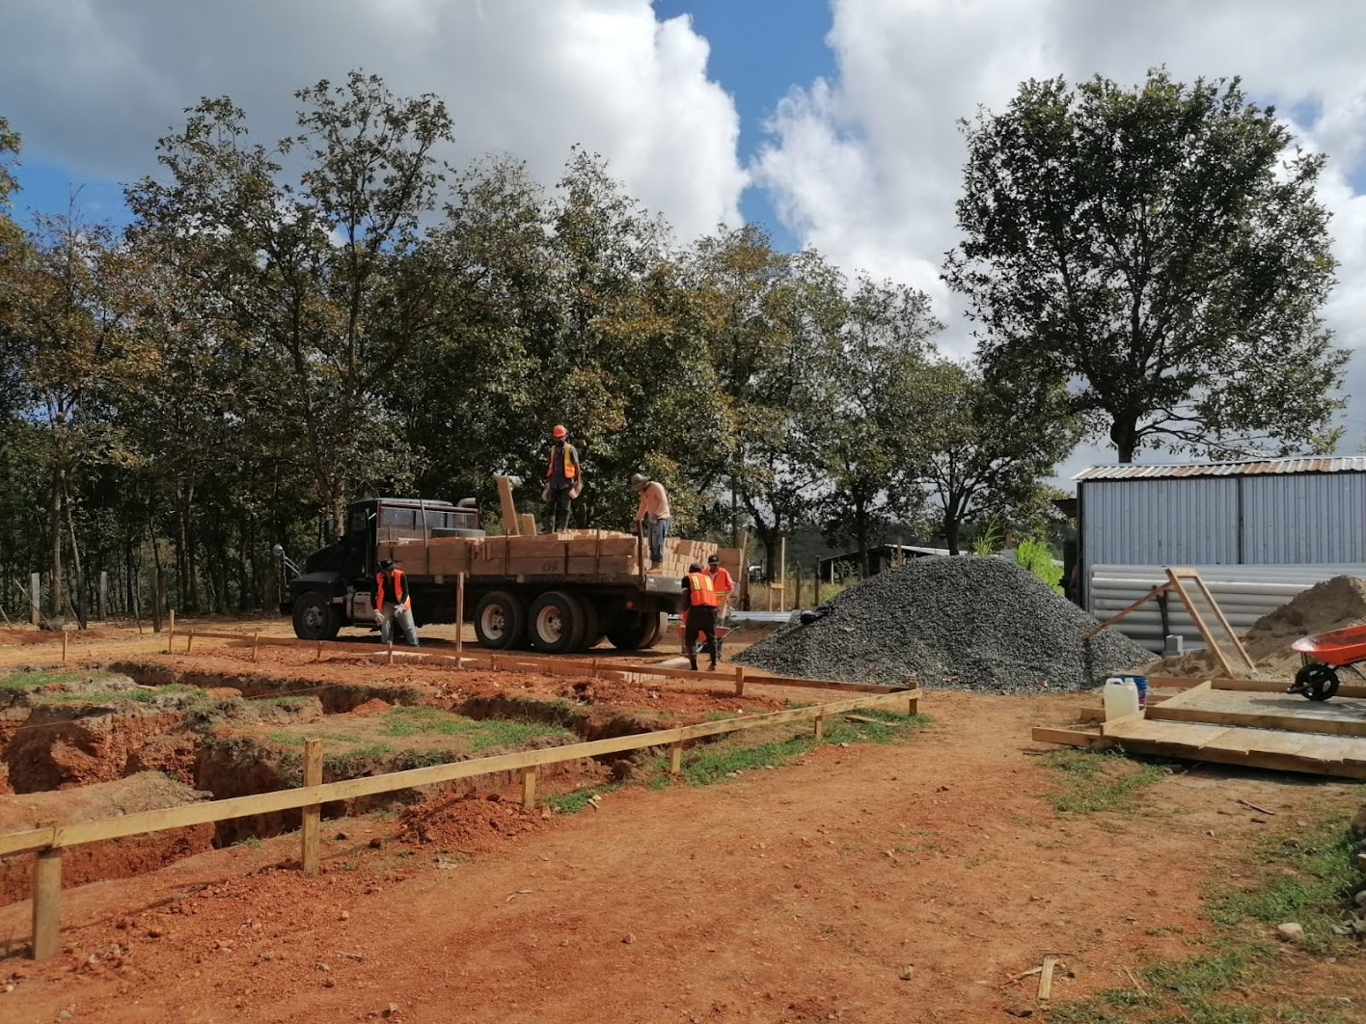

Slide 20
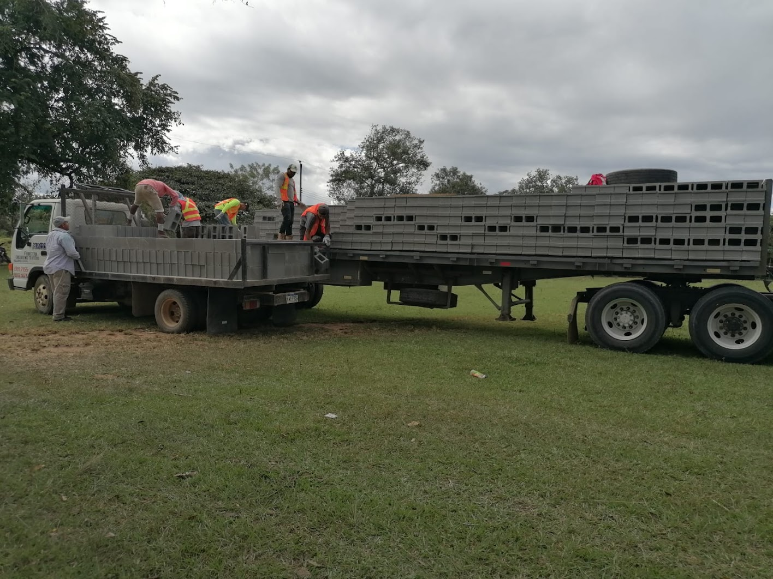

Slide 21
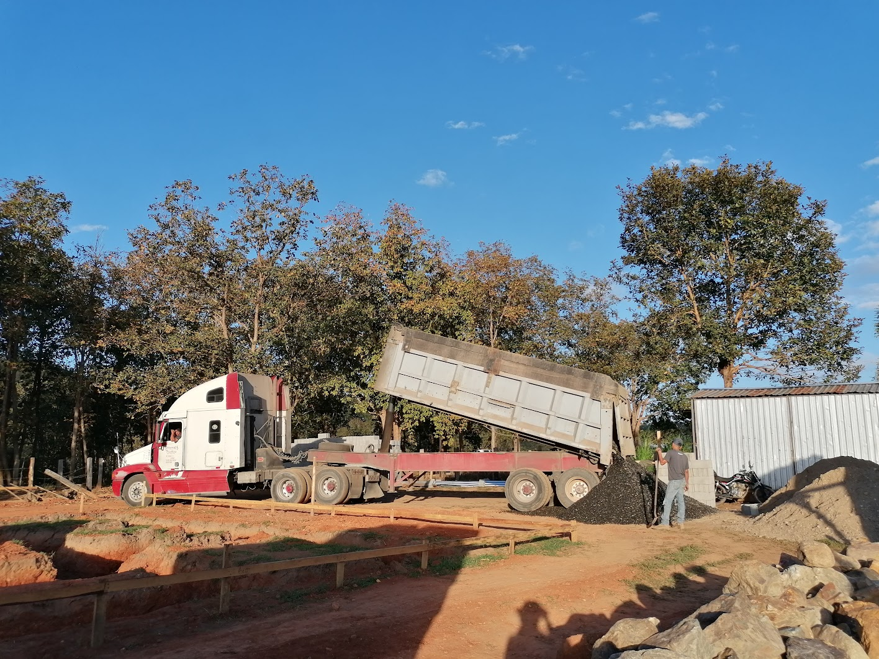

Slide 22
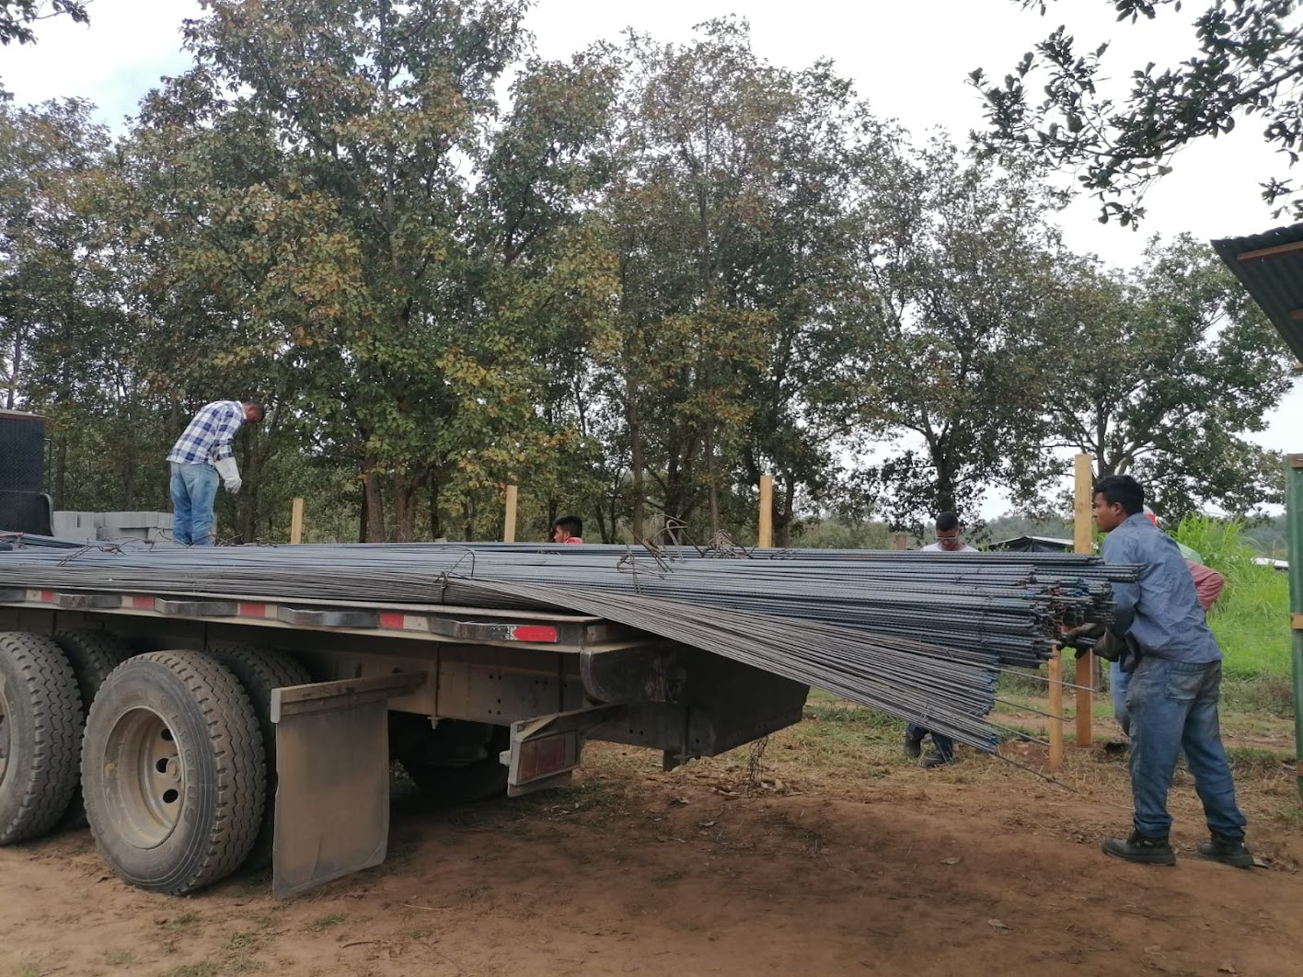

Slide 23
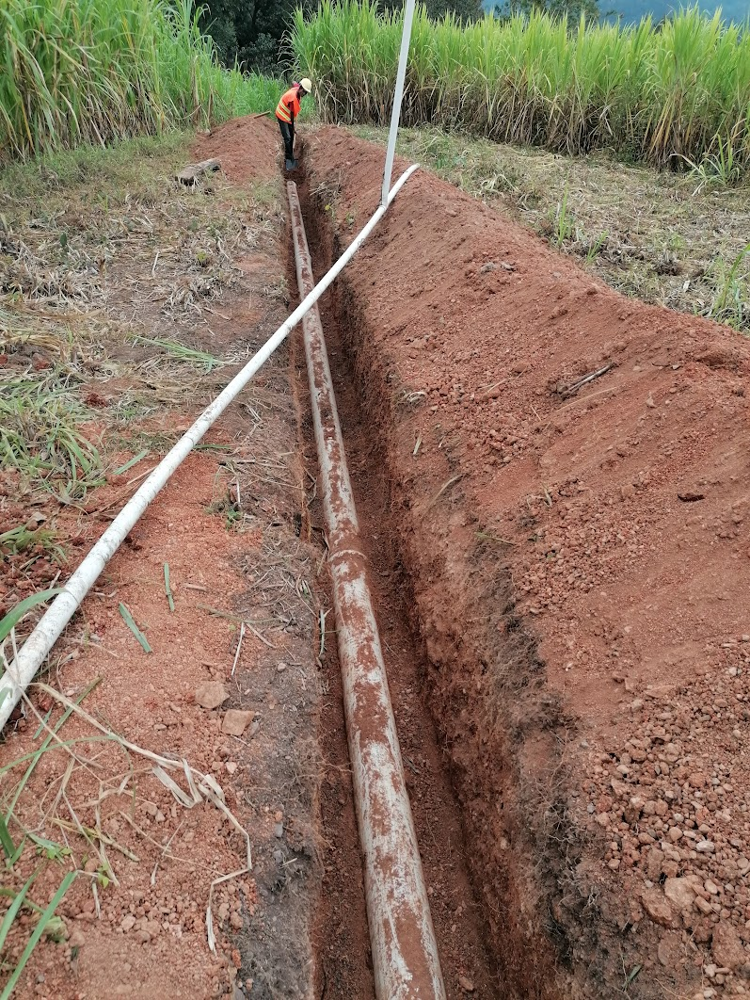
Source water transmission line
Uncovering the water pipe to eventually make the connection to the plant

Slide 24
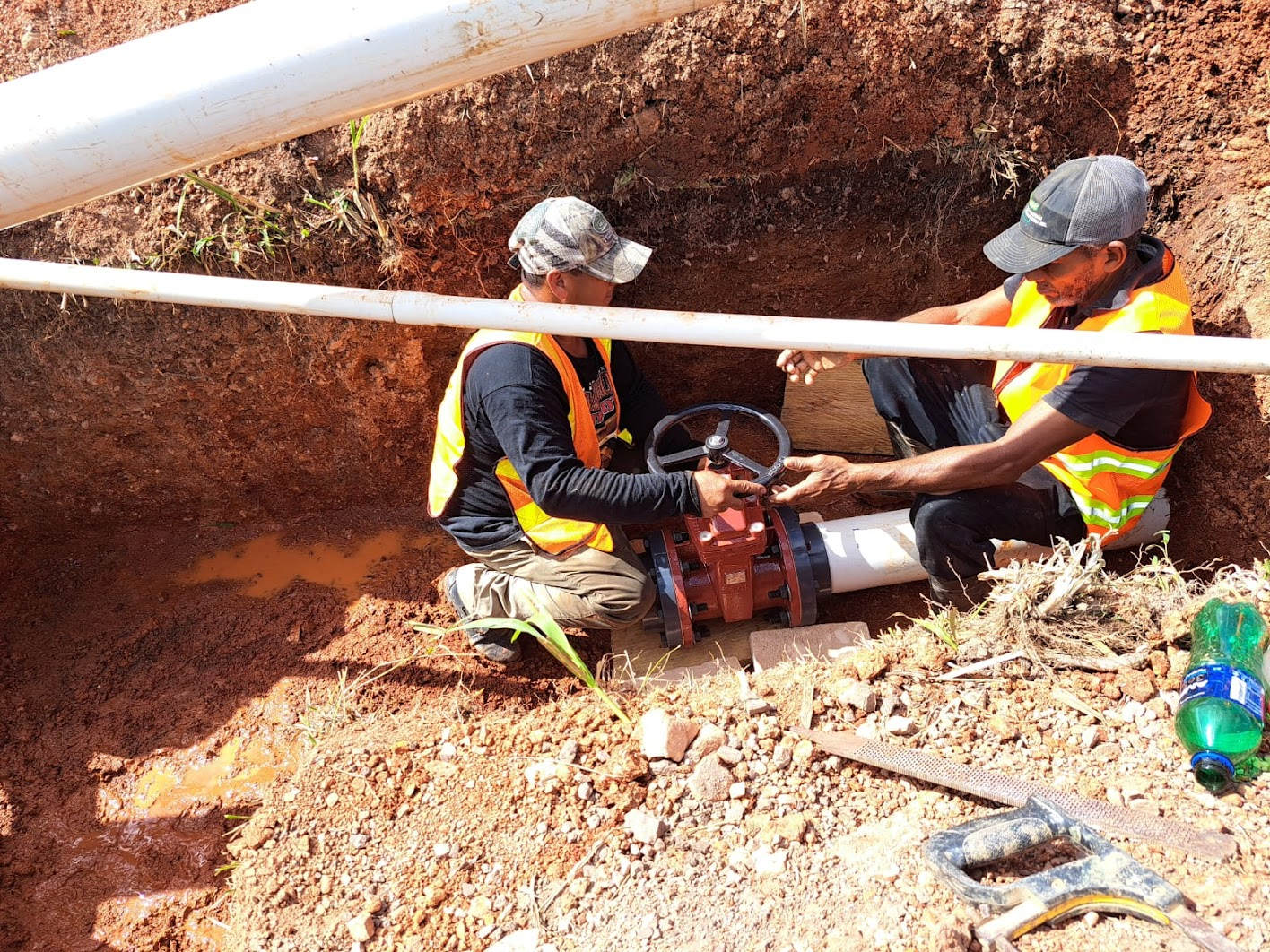

Slide 25
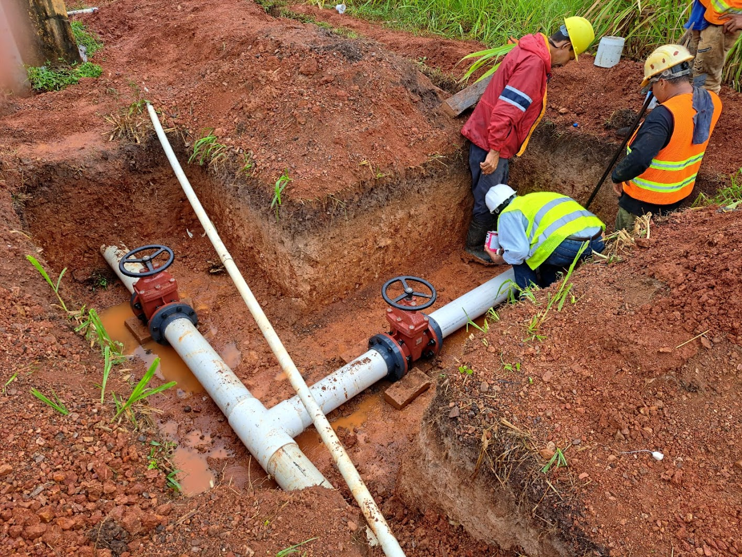

Slide 26
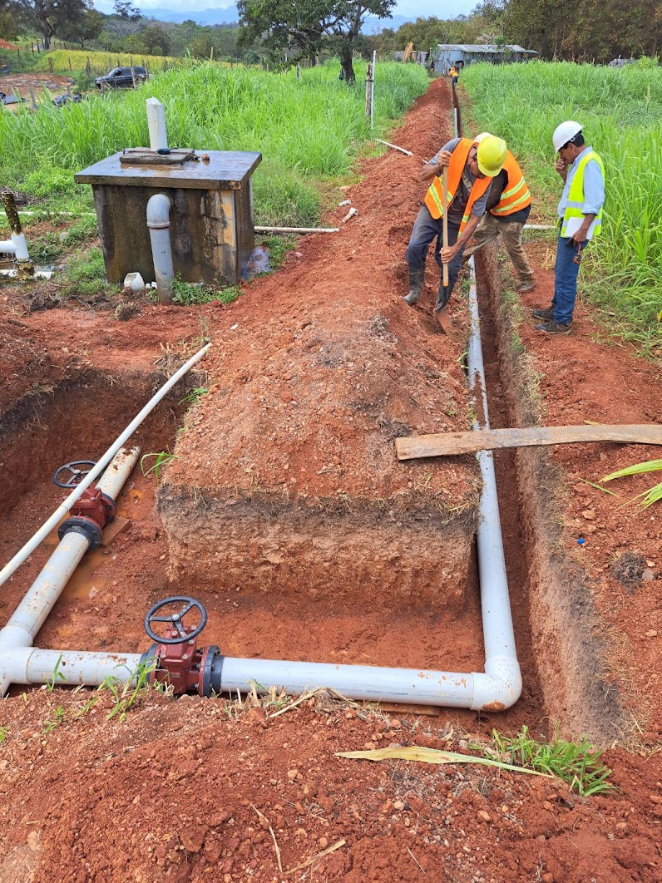
Tie in to transmission line
To AguaClara plant
Bypass to Becerra

Slide 27
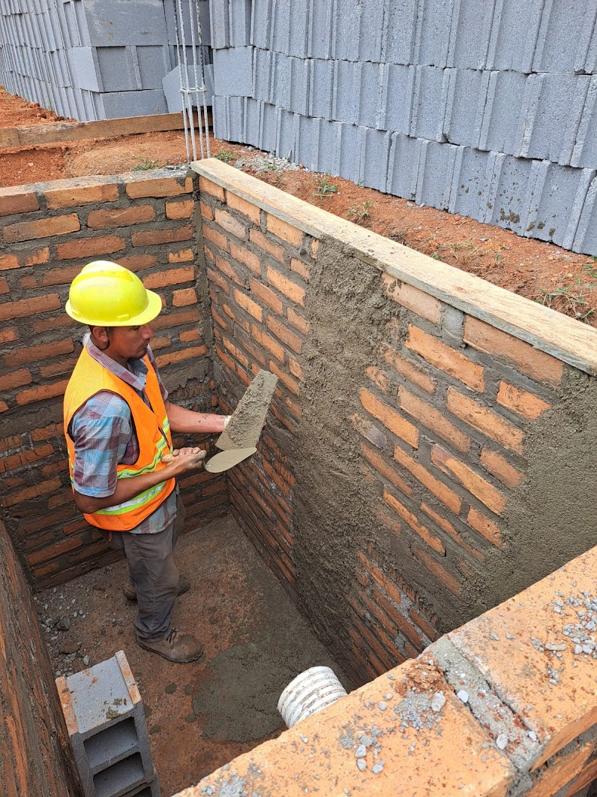
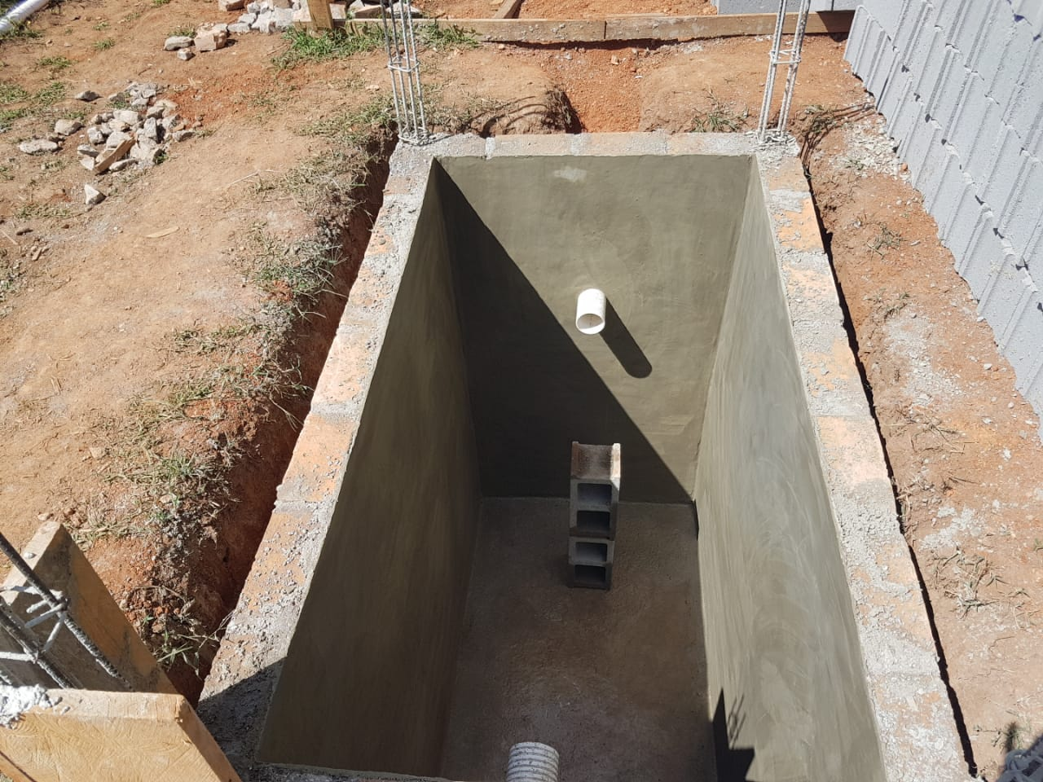
Septic Tank

Slide 28
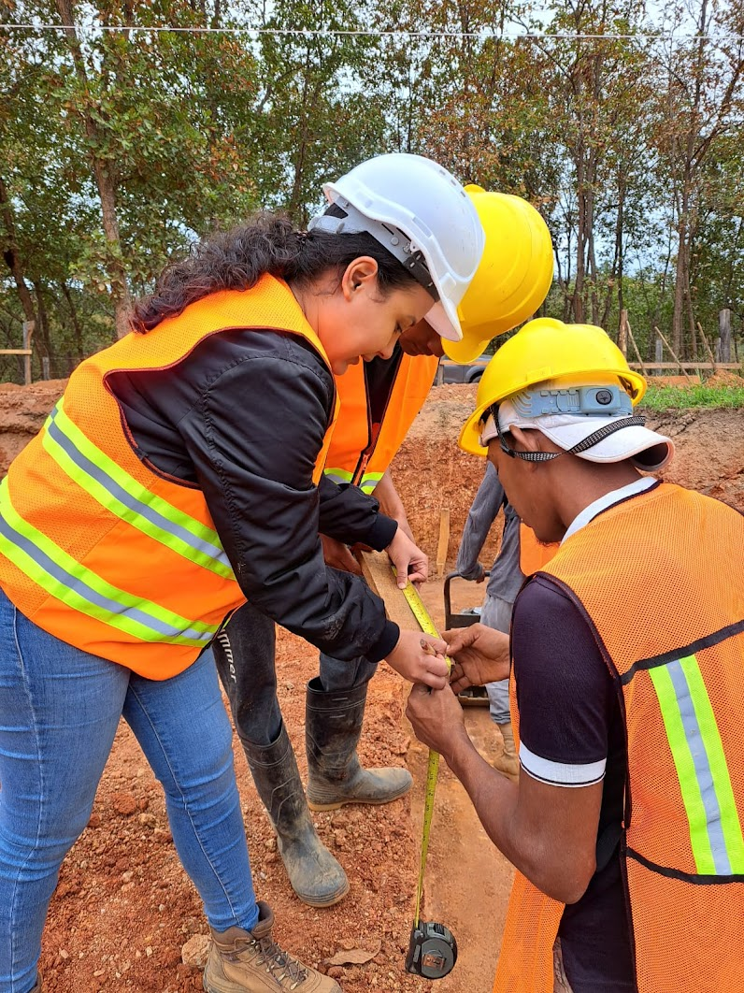
Site Engineer: Yellin Benitez Nuñez

Slide 29
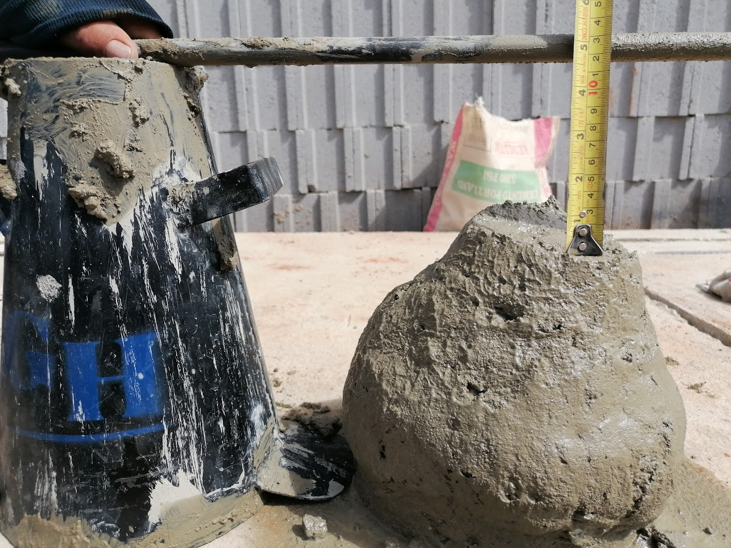
Slump test

